Slide 1
Health Violation Analysis for LA Restaurants
How safe is the food we consume in LA restaurants?

Slide 2




TEAM 3 MEMBERS
#Team3Rocks
Allison Hsu
Maritza Lopez
Binqian Gao “Jessica”
Data Analyst Whiz!
Data Analyst Prodigy!
Data Analyst Einstein!
Orlando Lepe
Data Analyst in training!

Slide 3
Original Project Hypothesis:
Is there a correlation between star rating and health violations?
Do high starred restaurants show higher propensity for health violations?
Do lower starred restaurants show a higher rate of health violations in comparison to higher starred restaurants?
What areas in the County have higher propensity of health violations in restaurants?
What type of restaurants, Mexican, Chinese, American, etc. show higher/lower health violations?

Slide 4
It’s all about the data
LA County Restaurant and Market Health Violations API from Data.gov. (2015-2018)
Yelp API

Slide 5
Issues with our data
Yelp API only allowed for 50 restaurant data per pull.
Limited our ability to do a thorough analysis.
We contemplated using Google places data, but matching restaurants from two data sets would be too cumbersome for scope of project.
Decided to change course of project and only relied on LA County data for analysis.

Slide 6
Yelp API Issues
{
"cell_type": "code",
"execution_count": 14,
"metadata": {},
"outputs": [
{
"name": "stdout",
"output_type": "stream",
"text": [
"Querying https://api.yelp.com/v3/businesses/search ...\n"
]
},
{
"data": {
"text/plain": [
"{'error': {'code': 'VALIDATION_ERROR',\n",
" 'description': '300 is greater than the maximum of 50',\n",
" 'field': 'limit',\n",
" 'instance': 300}}"
]

Slide 7
Modified Project Hypothesis:
How many violations are committed per year?
Which month exhibits highest number of violations?
Is there correlation between size of the restaurant and propensity to commit violations?
Which restaurants commit the highest and lowest violations?

Slide 8
Let’s get technical!
Our team of expert data analysts spent countless hours cleaning and formatting data for a better outcome.
Data Exploration
Data Cleanup
Data Visualization
Through Jupyter notebook we used python and pandas to view data from data sources and determine:
Quality of data
Quantity
Relevancy to purpose of project
Completeness
We used python and pandas to clean and manipulate the data. We used the following techniques/functions:
Binning
Groupby
Needed to separate market data from data set
Developed new dataframes
Loops to run through data
Our visualization consisted of using Matplotlib through pandas and python to create the following:
Vertical Bar Charts
Horizontal Bar Charts

Slide 9




The data says!
We learned some interesting facts about LA restaurants!
The smaller you are the harder you fall!
2016 was a bad year!
Restaurants committed 96,989 violations in this year, highest of the 4-year span.
Restaurants with smaller seating capacities had higher number of violations.
June gloom!
Dodger blues!
On average, more violations were committed in June than any other month.
Dodger stadium had the highest number of violations than any other establishment.

Slide 10
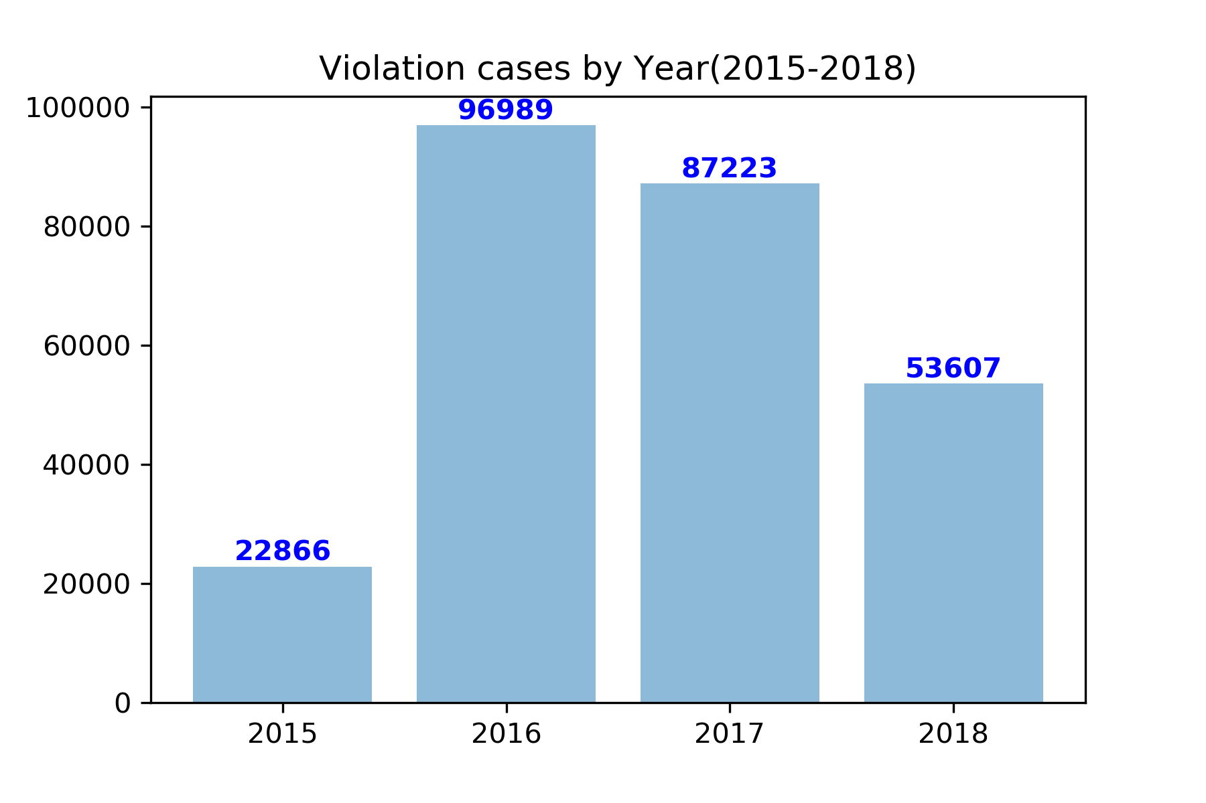
2016 was a bad year!
Observation 1
Observation 2
2016 had the highest total number of violations of the 4-year span.
2017 showed a 10% decrease in the total number of violations from 2016.

Slide 11
June gloom!
Observation 1
Observation 2
June exhibited the highest number of average violations of all the months.
November showed the lowest average of violations.

Slide 12
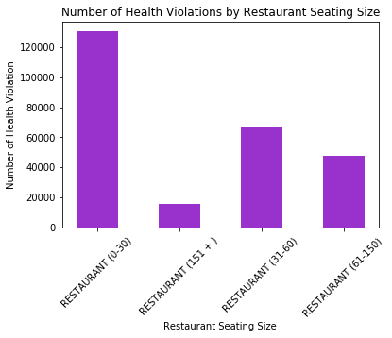
The smaller you are the harder you fall!
Observation 1
Observation 2
Smaller restaurants with seating capacity of 1-30 seats had the largest number of health violations.
Conversely, larger restaurants with 151 or more seats exhibited the lowest number of violations in the 4-year span.

Slide 13
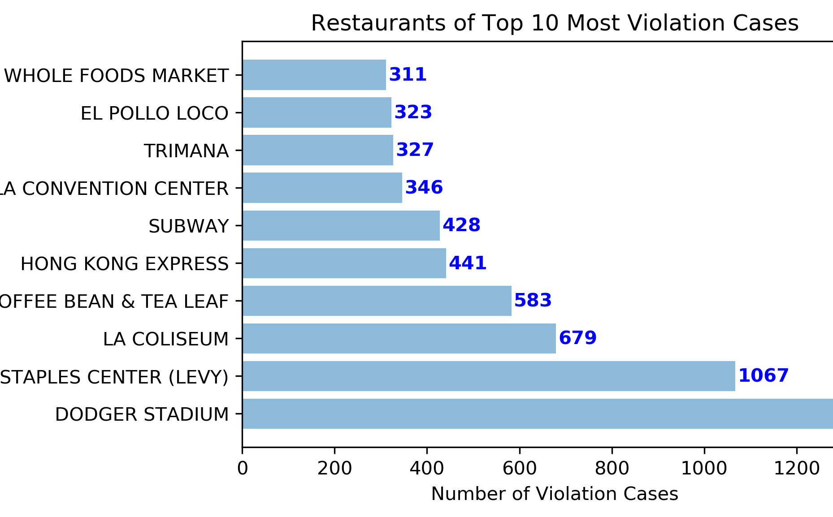
Dodger blues!
Observation 1
Observation 2
Sporting event facilities that serve large crowds had the largest number of health violations.
Dodger stadium had the most violations of all the restaurants in LA County.

Slide 14
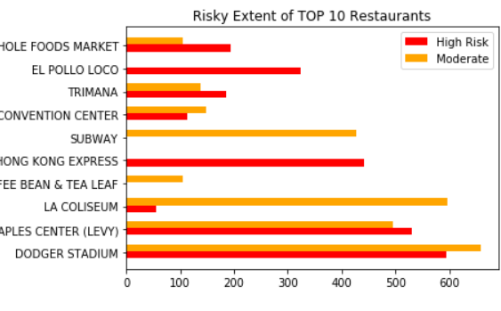
A risky proposition!
Observation 1
Observation 2
Sporting event facilities that serve large crowds have higher risk of committing violations.
Coffee Bean was the safest establishment against health violations.

Slide 15
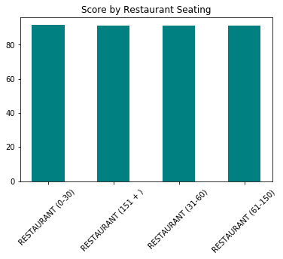
Health conscious!
Observation 1
Observation 2
The average health score for all restaurants inspected was 91.3.
Seating size for restaurant was not a factor in the health score for the restaurant.

Slide 16
What did we learn?
The data provided some interesting insights

Slide 17
SUMMARY
Although we had to change focus of original idea, we learned a lot about some characteristics of restaurants that commit the most and least violations.
We also learned that eating at a sporting event might not be a good idea.
There’s a lot more exploration through advanced statistical analysis to find correlations!
Link local demographic data and geographic data, we can do factor analysis to find unobserved variables among various restaurants.
By conducting a survey to get consumer perception, we can do hierarchical regression to find more correlations with health inspections.

Slide 18

THANK YOU!

Slide 19

Q&A

